Slide 1

Berkeley MaCSS Capstone 2026 Partner
Final Presentation
Hanning Zhou, Juan Rubén Gomez, & Fuguan O’Brien
Notes:
Hanning

Slide 2




Who’s Involved?
Who we are
Ruben Gomez
Data Visualization
Fuguan O’Brien
Project Leader
Hanning Zhou
Research Manager
Identify research gaps
Generate rigorous evidence
Strengthen evidence quality & inclusivity
Translate evidence into action
Notes:
Hanning

Slide 3



The Problem
Since 2011, 13M+ Syrians displaced
A Population Without a Permanent Record
Fragmented & Static Data Ecosystems
Data collected one-time
Data on Syrian refugees exists, but remains inaccessible but this is changing with the fall of the Assad regime as more Syrians return to Syria
No Mechanism to Visualize Migration Patterns
across borders & over time
Policymakers, Researchers, NGO’s, and others
? need clusters & target support
Policy decisions often based on intuition, not data.
Notes:
Hanning
Alternative slide
The Problem: Data on Syrian refugees exists, but remains inaccessible for policymakers and researchers to act on
Who are these Syrian refugees? They are a population without a permanent record who are displaced
The data on this population is fragmented and Static across data ecosystems
And there is no mechanism to visualize their migration patterns
This causes a situation where data cannot reach Policymakers to act on.
Who are they? Population
13M+ Syrians displaced since 2011
Lack of reliable evidence for policy/research
Policy decisions often based on intuition, not data
Fragmentation
Refugee data often collected one-time and fragmented
5-year panel study helps fill the gap
Findings not easily accessible
Difficulty identifying needs and targeted support
Refugee movements across borders + settlements over time
Hard to identify need clusters and target support

Slide 4


Our Approach
The Dataset
2,600 refugee households tracked longitudinally
5 waves of data collection over 5 years (2020-2024)
Outcomes: employment, fertility, marriage, consumption, health, mental health, intentions to return
Data delivered as CSV in weeks 6–7 from Stata
Notes:
Fuguan
Panel study tracking 2,600 Syrian refugee households over 5 years — rare longitudinal depth for this population
5 waves of data collection, one per year from 2020–2024, letting us see how lives actually change over time
Outcomes span nearly every dimension of household wellbeing: employment, fertility, marriage, consumption, physical health, mental health, and intentions to return
Data was originally in Stata — access challenges delayed delivery by several weeks
CSV format arrived in weeks 6–7, which opened the door for the approach I'll describe next

Slide 5


Our Approach
Project Timeline
Wk 1–3
Wk 4–6
Wk 6–7
Wk 8–12
Onboarding
& Data Attempts
Data Access
Challenges w/Stata
CSV Received +
+ Claude Code Pivot
Dashboard(s)
Built & Delivered
Notes:
Fuguan
Weeks 1–3: Onboarding, team alignment, and early attempts to access the data
Weeks 4–6: Hit significant friction with Stata — couldn't get reliable access to run analyses
Weeks 6–7: CSV delivered — pivoted immediately to Claude Code, which let us move fast despite the delay
Weeks 8–12: Compressed the full analysis and dashboard build into roughly 5 weeks
Key takeaway: a 6-week data delay didn't derail the project — the pivot to CSV + Claude Code recovered the timeline
Next few slides will be three out of 6 dashboards

Slide 6
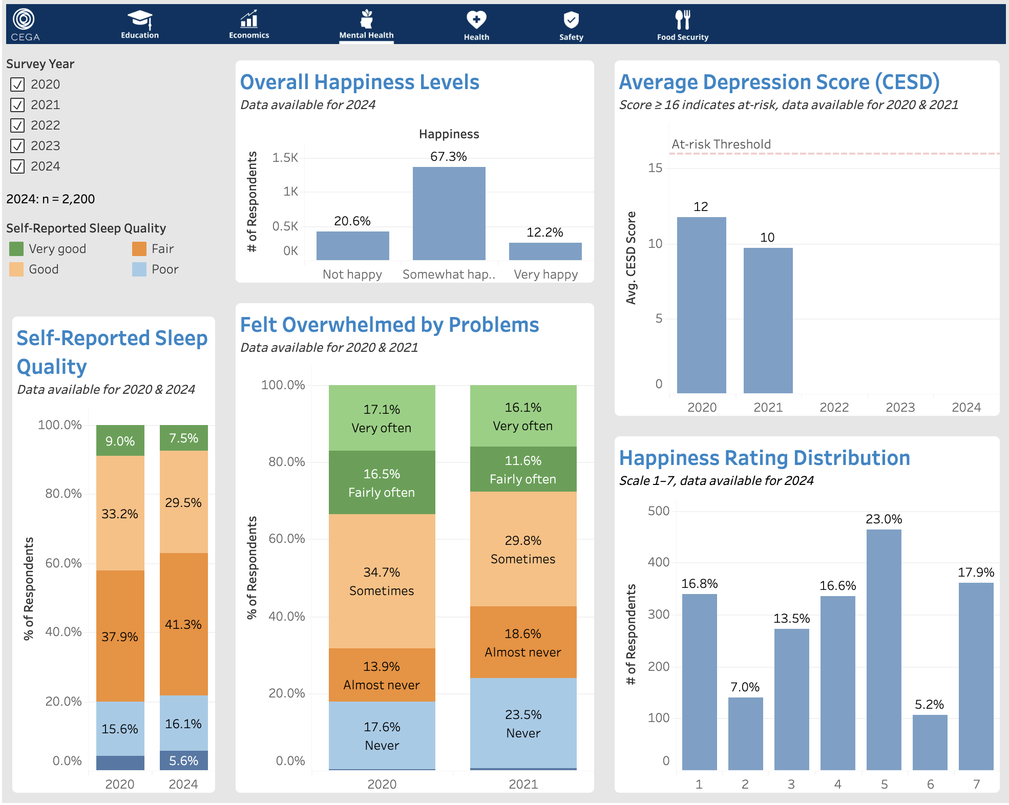
Mental Health Outcomes
Key Findings
Sleep is getting worse: "very good" sleep dropped from 9% → 7.5%, while “fair”/"poor" grew
Depression improved early, scores fell 11.8 → 9.7 by 2021, no data since
Happiness is flatlining, not flourishing: 67% somewhat happy, only 12% very happy
Stability is not recovery.
Programs should push toward lasting wellbeing, not just crisis prevention.
Notes:
Fuguan
Happiness is moderate but not strong
- 67% somewhat happy, only 12% very happy
- Matters: programs are stabilizing people, not improving their lives
- Rec: add a question that separates "coping" from "doing well"
Depression improved early on
- Scores fell 11.8 → 9.7 (2020–2021), below the at-risk threshold of 16
- Matters: no data after 2021 — we don't know if it held
- Rec: bring back this measure in later waves and tie it to who kept vs. lost support
Sleep is getting worse
- "Very good" sleep dropped from 16% to 6%; poor quality rising across the board
- Matters: bad sleep predicts worse mental health, work, and child outcomes down the line
- Rec: look at housing and financial stress as root causes — cross-check against employment data

Slide 7
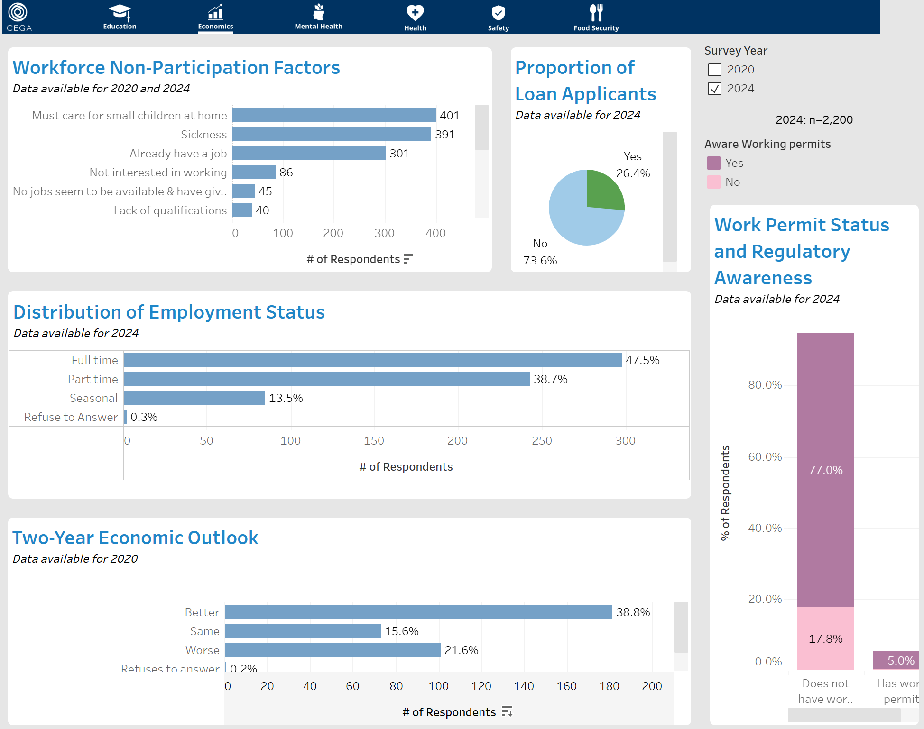
Economics
Key Findings
Caregiving and health issues are the main barriers to employment.
Most respondents lack work permits and don’t know the relevant regulations.
In 2020, financial optimism outweighed pessimism among respondents.
Economic participation is currently stalled by structural barriers (childcare) and information asymmetry (permits).
Notes:
Hanning
Employment & Workforce Participation
Childcare and Health as Primary Barriers: Caregiving responsibilities and sickness remain the leading factors preventing workforce participation.
Dominance of Full-Time Employment: Among active workers in 2024, full-time roles are the most common pattern, significantly outpacing seasonal work.
The "Discouraged Worker" Gap: A notable portion of the population is not participating because they believe no jobs are available or they lack specific qualifications.
Economic Sentiment & Financial Activity
Optimism Amidst Uncertainty: In 2020, more respondents expected their economic situation to improve than those who expected it to worsen.
Low Penetration of Loan Applications: Only about 26% of the surveyed population applied for loans in 2024, suggesting limited engagement with formal credit.
Regulatory Awareness & Work Permits
Critical Gaps in Work Permit Literacy: While a majority of respondents do not have a work permit, a significant portion of that group is also unaware of the regulations surrounding them.
The Awareness-Status Paradox: Only 5.03% of the total respondents both possess a work permit and are aware of the relevant regulations.
High-Level Summary Titles
2024 Economic Snapshot: Employment Stability vs. Regulatory Barriers
Barriers to Entry: Analyzing Workforce Non-Participation and Permit Awareness
Financial Inclusion and Labor Trends: A Multi-Year Comparative Study

Slide 8
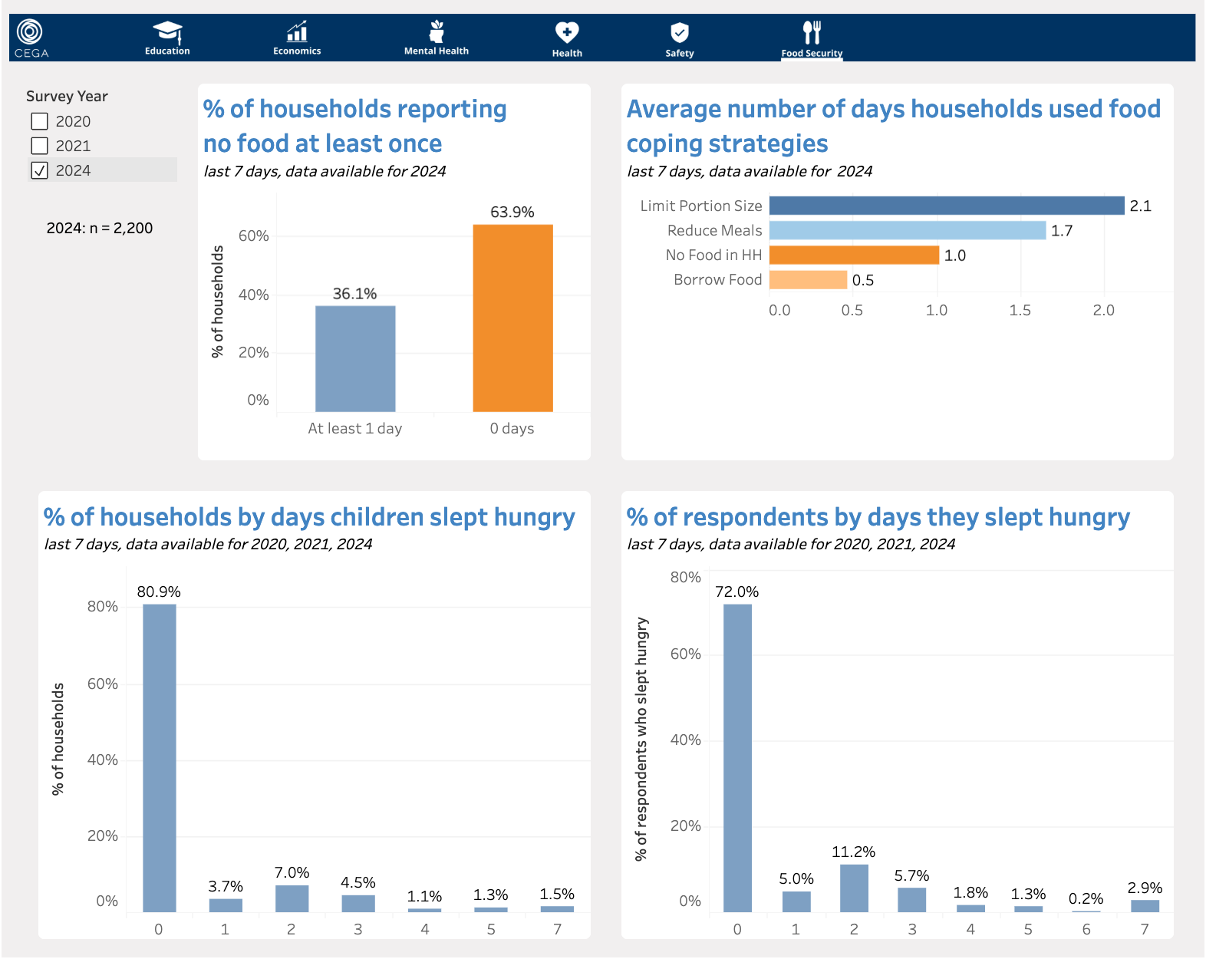
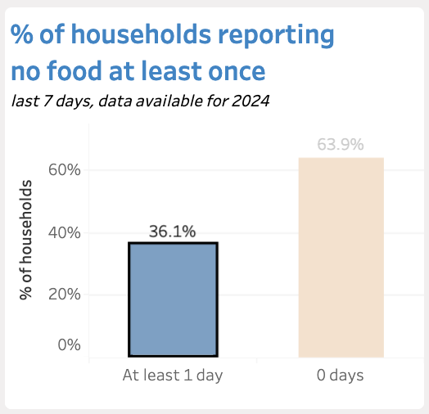
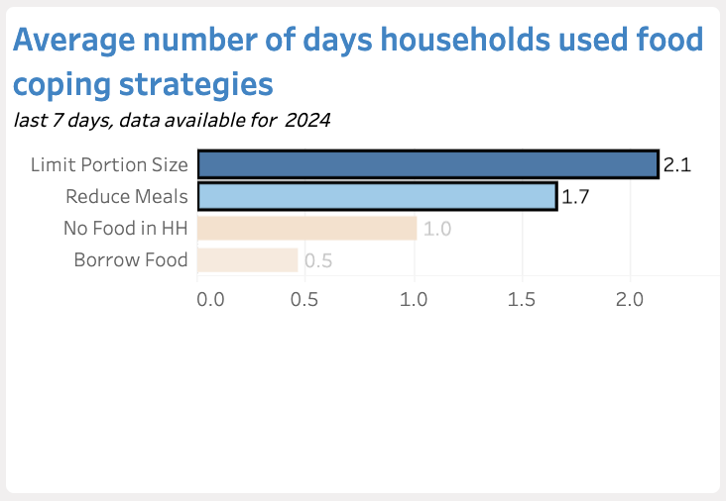
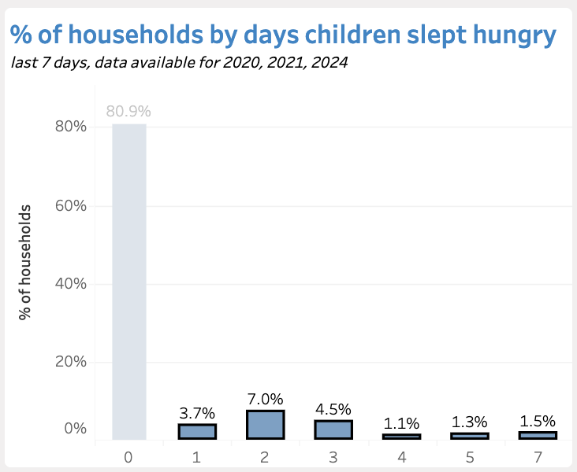
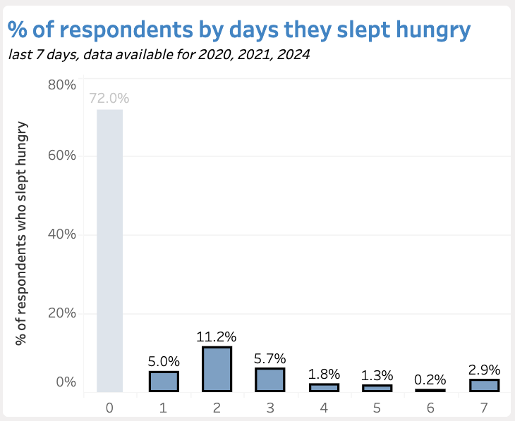
Food Security: Refugees are adapting to Hunger
Key Findings
1 in 3 households run out of food each week
Households are rationing by Meal Portioning and Meal cutting ~2x per week
20% of Children go at least 1 day without food weekly
30% of Adults go at least 1 day without food weekly
Syrian refugees are managing scarcity not escaping it.
Policy interventions must prioritize sustained, reliable food access.
Notes:
Ruben
Data on Food security tells us that Refugees are adapting to hunger.
In 2024, 1 in 3 households ran out of food each week
How are households adapting?
They are rationing by Portioning and Cutting Meals about 2x per week
Who is affected? Children. While Child hunger is minimized it’s not absent.
20% of children go atleast 1 day without food on a weekly basis.
Adults also experience food insecurity. Where nearly 30% of adults go without food on a weekly basis.
The truth is that Syrian refugees are managing scarcity not escaping it.
Policy interventions must prioritize sustained, reliable food access.

Slide 9
Summary: Refugees are living in Instability
Mental Health
Economics
Food Security
Well-being is plateauing
Work is
out of reach
Hunger is
normalized
Sleep is worsening, happiness is flat
Caregiving, illness and lack of permits limits employment opportunities
Adults and children regularly go at least one day without food
Many refugees are returning to Syria after the authoritarian President Bashar al-Assad fled the country, causing the centralization of a once dispersed community.
CEGA will use these dashboards as an aid to raise funding for future research about the experiences of this population.
Notes:
Ruben
In summary, what we are seeing is that refugees are living in instability
Mental health data showed us that
well-being is plateauing.
We are seeing that sleep is worsening and happiness is flat.
Data on Economics tells us that
work is out of reach.
Where caregiving, illness and lack of permits are stifling employment opportunities.
And lastly, data on Food security tells us that
Hunger is being normalized.
Where children and adults reguarly go at least one day without food.
The impact?
WE see that Households are managing survival but lack clear pathways to sustained recovery.
There is a change that’s occurring as we speak.
Refugees are returning to Syria after the authoritarian president Bashar al-Assad fled the country,
Now more syrians are centralized making it slightly easier to research this population.
CEGA will use the 6 dashboards that we built to raise funding for future research in aid of this population.

Slide 10



Next steps: Offboarding strategy
01
Deliver the six completed dashboards to CEGA for website implementation.
Transition Dashboards and assets to CEGA
02
Standardize the Python cleaning workflow and document the Stata-to-CSV handoff to speed access and prevent delays.
Share Reproducible Data Pipeline
03
Provide detailed documentation for easy integration to Harvard Data Verse and subsequent research studies.
Documentation
Notes:
Ruben
What happens next? We will be off-boarding
We will transition assets to CEGA delivering dashboards to be integrated onto the CEGA website
We will share reproducible data pipelines. Standardizing Python cleaning workflows as well as Stata to CSV conversions.
Lasty, our documentation will provide details for easy integration to the data hosting platform Harvard Data Verse and for ongoing annual research studies.

Slide 11
Thanks!
Questions or comments?
CEGA
x
Hanning Zhou, Juan Rubén Gomez, & Fuguan O’Brien
Notes:
Thank you to Prof Kaleve, our partners at CEGA, Prof Miguel, Prof Emily, Yazen, Paula, and Mansi.

Slide 12
Appendix

Slide 13


Next Steps
Caveats & Limitations
Future Directions
Data cleaning and preprocessing (Stata -> Python and Tableau)
Narrowed scope to focus on dashboards
Mindful that self-reported outcomes may have social desirability bias
Build spatial migration tracking & mapping
Integrate Wave 6+ data
Standardize Stata data access
Partner with UNHCR for admin data
Explore predictive models
Notes:
What remains? Limitations and future directions.

